Slide 1


COMPARE
CART

Slide 2

LOGIN PAGE
USER NAME : EMAIL :
PASSSWORD :
DOB :
ADDERSS :
MOBILE NUMBER:

Slide 3
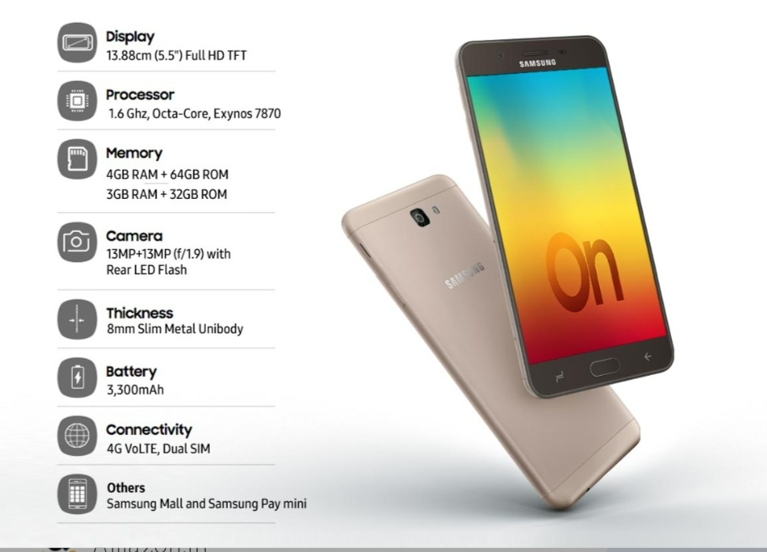
GADGET
INFORMATION
SPECIFICATIONS
COLOUR
SIZE

Slide 4
DISPLAYED
TO CUSTOMERS
Shipment and delivery charges
Brand of the gadgets
Price of the gadgets
Public review and ratings
Stock quantity of all gadgets
Offers , availability and replacement of the gadgets

Slide 5
REQUIREMENTS FROM SELLERS
NAME
BANK DETAILS
OWNERSHIP OF THE GADGET
AUTHORISATION
COMPANY

Slide 6


FEATURES
BEGINNER FRIENDLY
OPTIMISED POWER USAGE
HIGH RESOLUTION IMAGES
CONTINUOUS NOTIFICATIONS
ATTRACTIVE USER INTERFACE

Slide 7

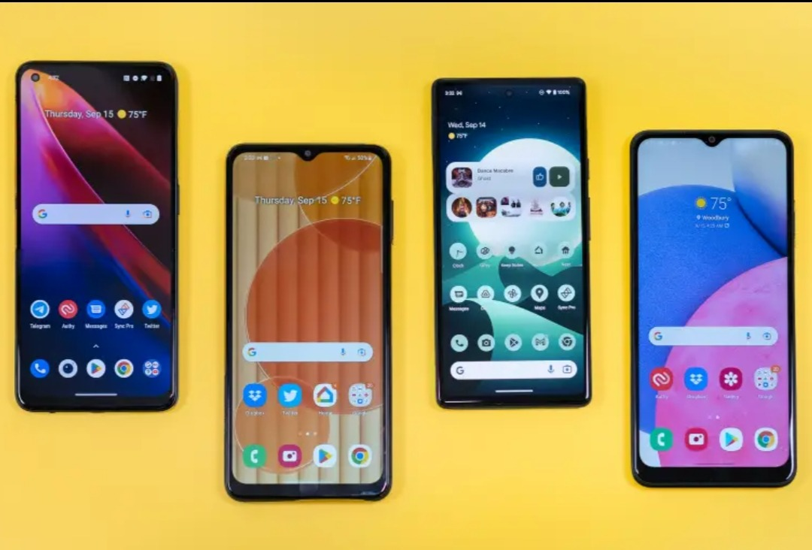

KEY FEATURES
MUTUAL PROMOTION
EXPERT OPINIONS
SPECIAL AI AND VOICE COMMANDS
MULTIPLE LANGUAGES
24/7 CUSTOMER CARE SUPPORT

Slide 8
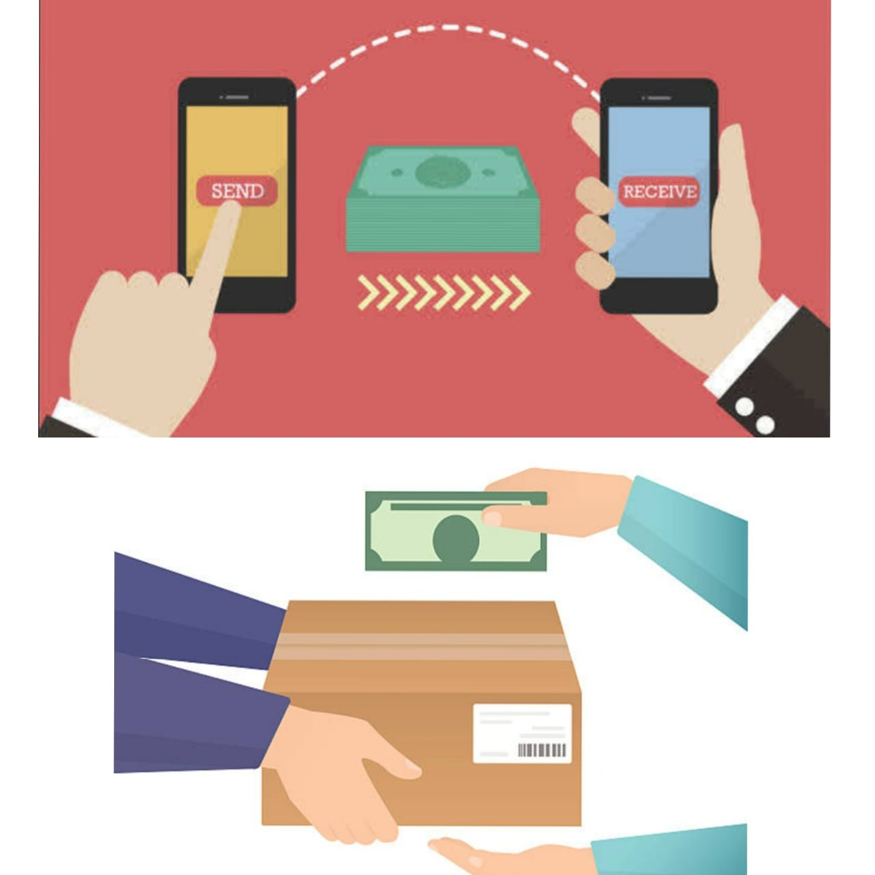
PAYMENT METHODS
ONLINE METHODS
UPI
PAYTM
CREDIT/DEBIT/ATMCARD
NET BANKING
EMI
OFFLINE METHODS
CASH ON DELIVERY
NOTE: REPLACEMENT AND REFUNDING IS AVAILABLE,
DELIVERING THE PRODUCT WITHOUT ANY DAMAGE

Slide 9


